Slide 1
The Demographics of Congressional Vote Preferences
David Sivieri
STAT8480 - PROJECT PHASE 2

Slide 2
Problem Motivation
Use recent election data in a data mining project.
Most of the 435 Congressional Districts continuously re-elect the same party in congressional elections – 90% party re-elect in 2018
Most seats stay held by the same party for long stretches of time.
Apart from incumbency advantage, what demographic factors give one party a durable advantage over the other in a given district.
Based only on demographics, find probability district will vote R or D.
Use Case: Political party wants to look for a potential flip and uses algorithm to find incumbent who is unnatural fit for district.

Slide 3
Election Data Source/Decisions
2018 Mid-term elections
MIT Election Data + Science Lab
Vote Total Results for District and County
435 Districts
3200 Counties – Lowest geographic level that matched input
Kept 37 candidates who ran unopposed
Provided useful info about district
Some districts cross county lines
Votes for party pooled – but different candidates

Slide 4
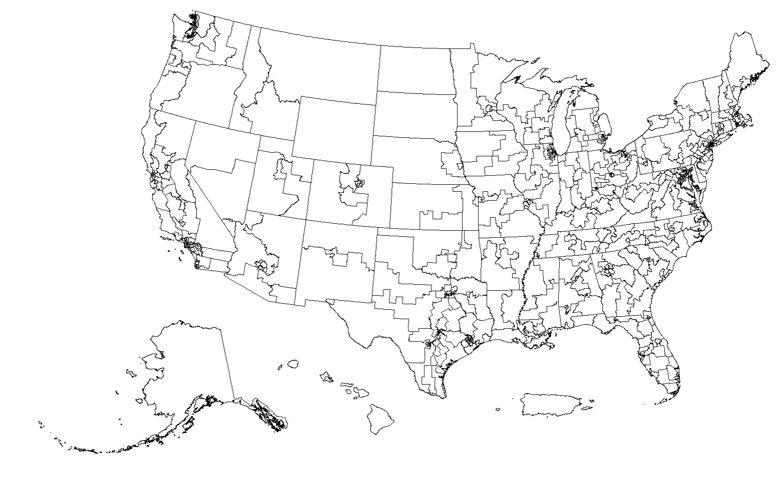
Congressional District Map

Slide 5
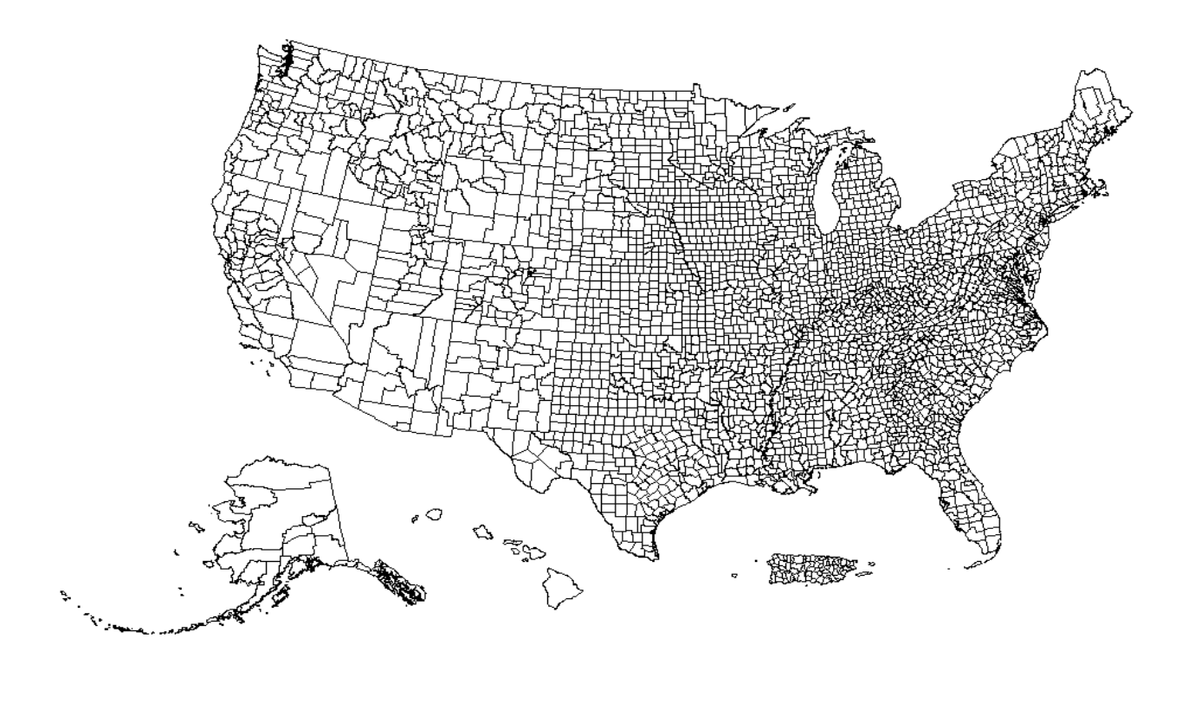
County Map

Slide 6
Target Variable
Party of winning candidate – Republican or Democrat
Coding was arbitrary 1 – Republican, 0 – Democrat
Care equally about predicting 0’s and 1’s
Also calculated proportion of vote each candidate won
Not used as input, but useful test of model

Slide 7
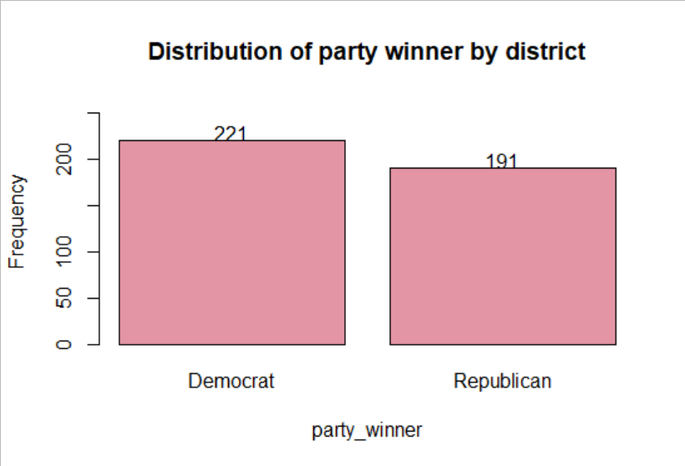
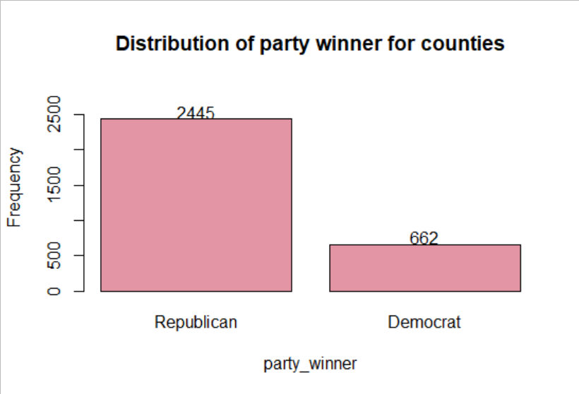
Target Party Distribution

Slide 8
Input Variables
American Community Survey (ACS)
Demographics survey program conducted by the U.S. Census Bureau
Summary tables and time series of population, housing, agriculture, and economic data from U.S. Census.
2014-2018 (ACS 5-Year Estimates)
tidycensus
R package - interface US Census Bureau’s data APIs
20 numeric variables
Provided for context by MIT’s Election Lab

Slide 9
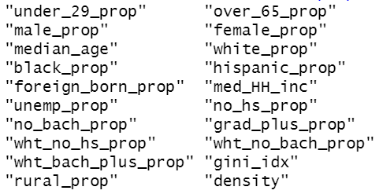
Input Variables

Slide 10
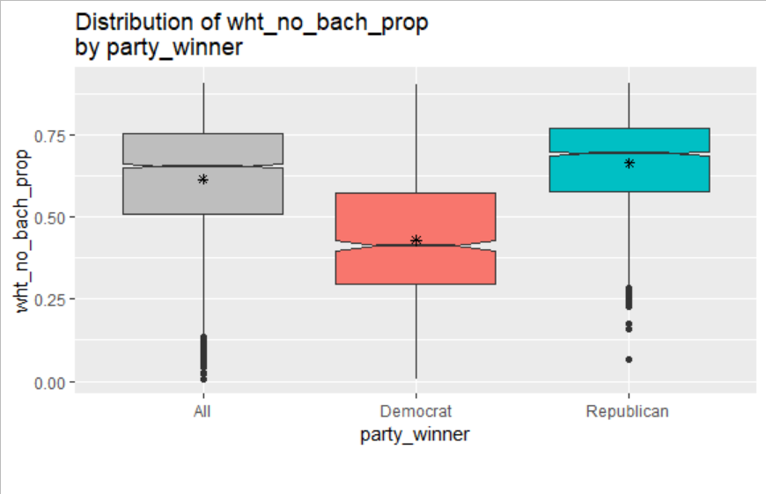
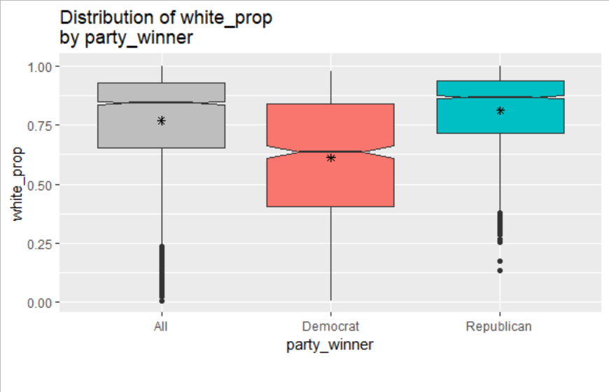
Important Variables - Counties

Slide 11
Data Issues
Downloaded input values for both districts and counties
Vast majority of counties and districts were complete
23 districts and 93 counties had very significant missing data
Important column was missing (rural proportion)
Decided to remove rows rather than impute because of importance.
Final Model
3107 Counties
412 Districts

Slide 12
Modeling
Four 4 Model Tried
Decision Trees
Random Forest
Logistic Regression
ANN
Different Datasets/Methodologies
District Only (naturally balanced)
County (highly unbalanced)
County (undersampled for balance)
County (alt-threshold)

Slide 13
Decision Tree – Models Details
Used Misc Rate for model pruning for balanced validation data.
Used F1 Score for model pruning for unbalanced validation data.
Let trees grow to maximum - cp = 0.0
Different Datasets/Methodologies
District Only (naturally balanced)
County (highly unbalanced)
County (undersampled for balance)
County (alt-threshold) ROC – top left

Slide 14
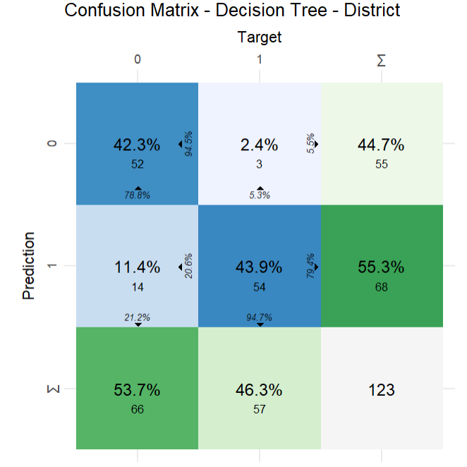
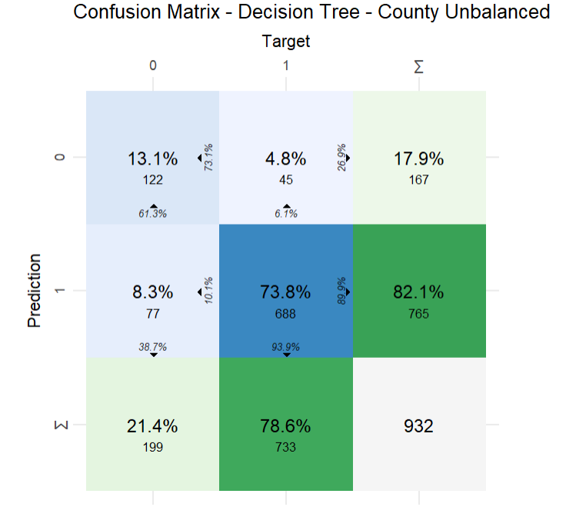
Decision Tree 70/30 Train/Test

Slide 15
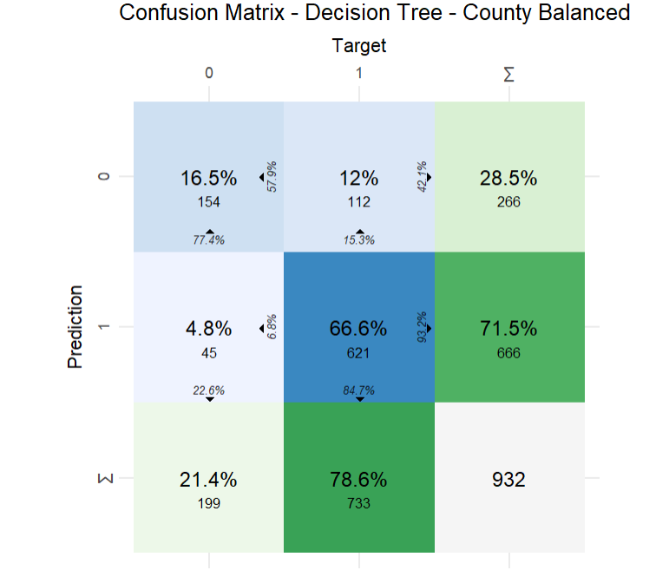
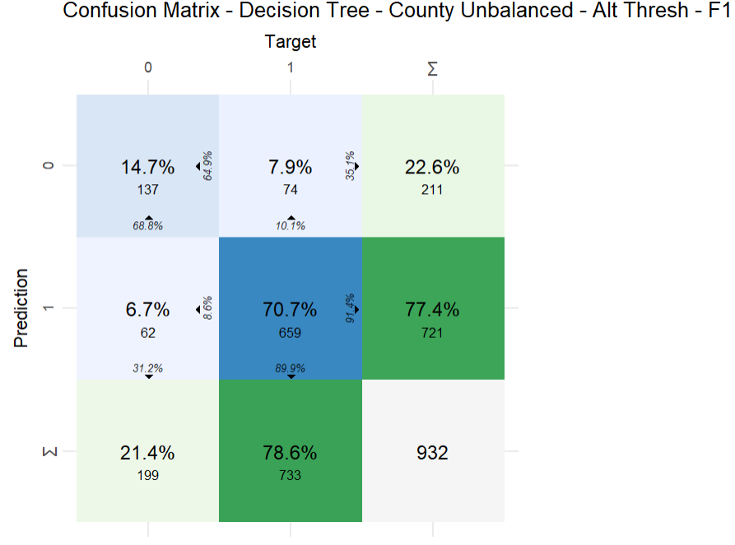
Decision Tree Balanced/Alt Thresh

Slide 16
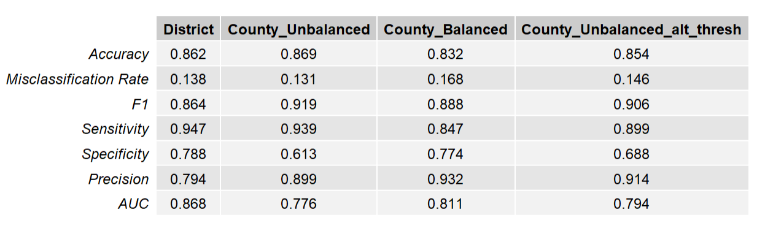
Summary

Slide 17
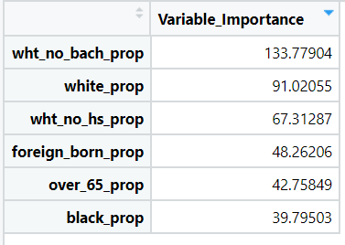
Important Variables County Balanced

Slide 18
Random Forest – Models Details
Set ntree to 1000 initially for tuning.
Final model error was stable at 200 trees
Used F1-score to tune mtry for unbalanced validation data
Three models
District
County Unbalanced
County Internally Down-sampled

Slide 19
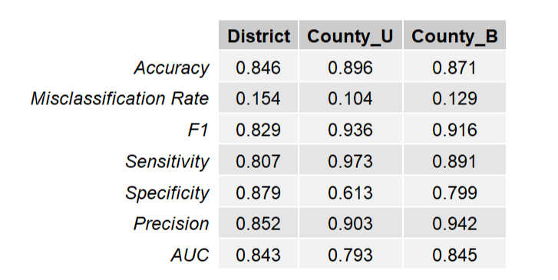
Random Forest Summary

Slide 20
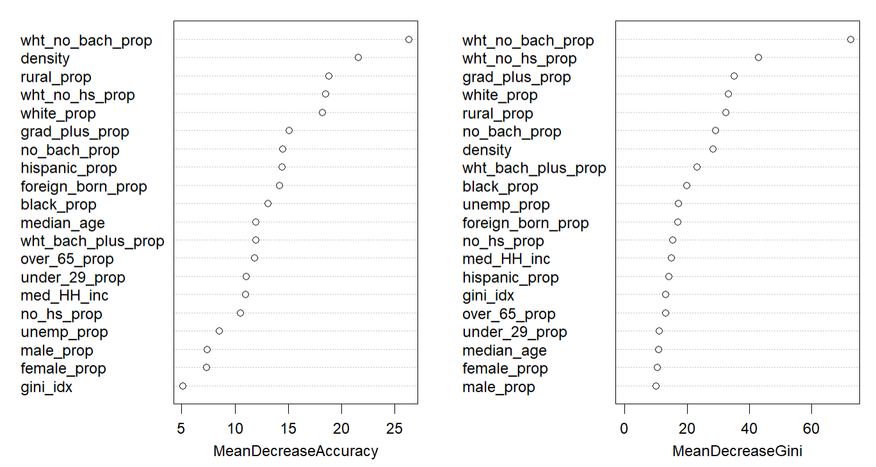
Rand Forest Var Import. County Bal.

Slide 21
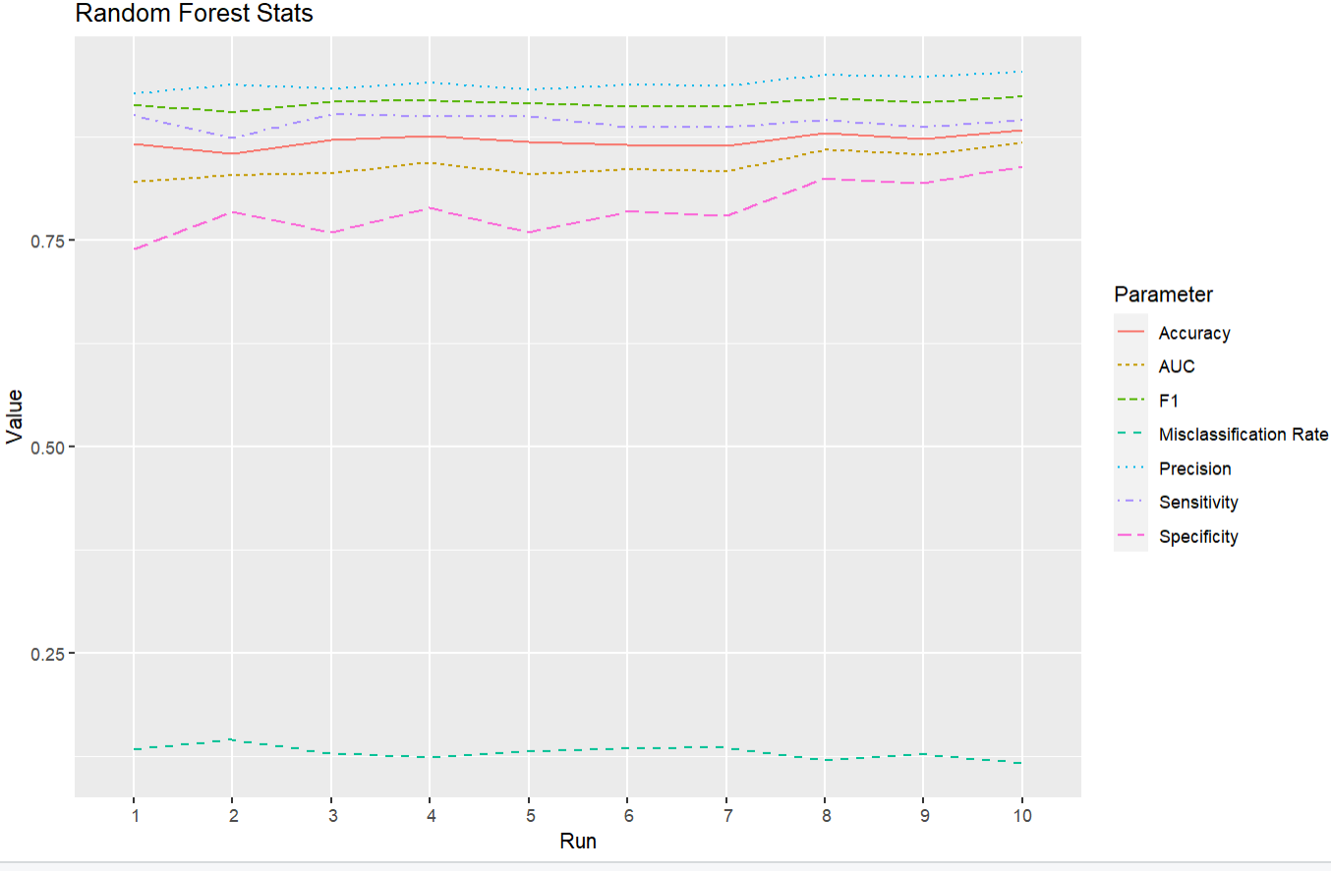
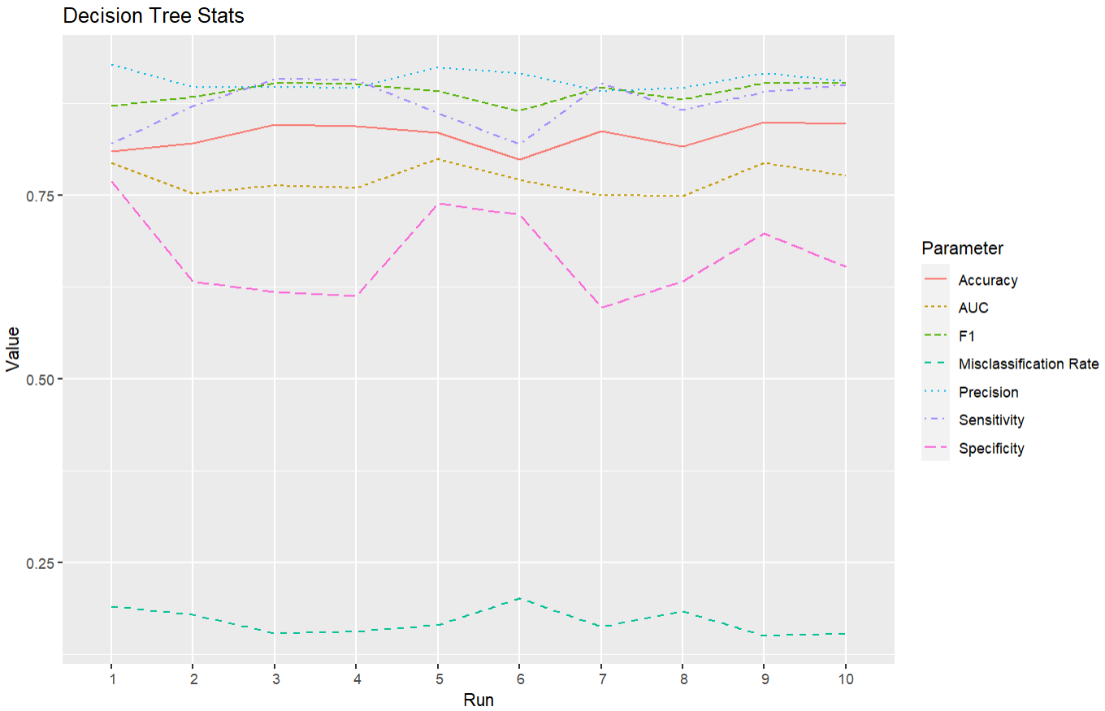
Decision Tree vs. Random Forest

Slide 22
Logistic Regression
Used Backwards Regression with BIC as model criterion
Used Box-Cox Transformations
Different Datasets/Methodologies
District Only (naturally balanced)
County (highly unbalanced)
County (undersampled for balanced)
County (alt-threshold) – Used Top-Left ROC Curve

Slide 23
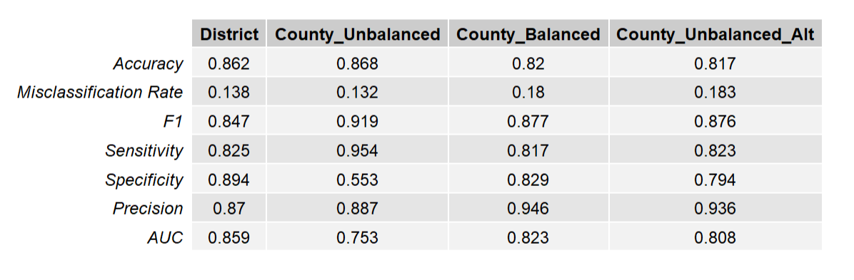
Logistic Regression Stats

Slide 24
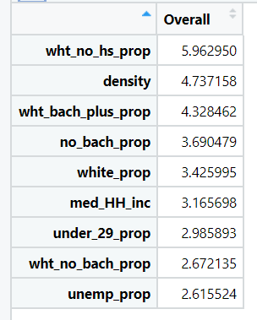
Logistic Regression Variable Importance

Slide 25
ANN – Model Details
Used variables selected from logistics regression
Scaled data
4 hidden neurons (experimented with range found no significant differences)
Binary Cross Entropy loss function

Slide 26
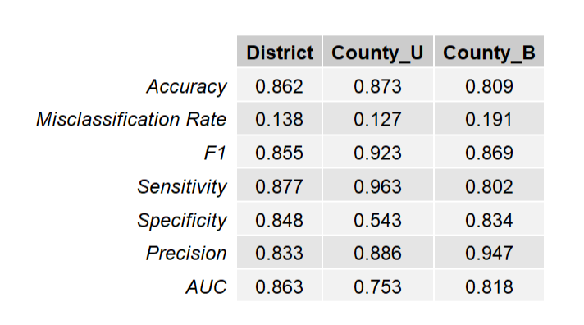
ANN Summary

Slide 27
Final Model
In all four models, the balanced county data had the best statistics
Probably captures more variation in demographic statistics
Most models produced similar statistics
Depending on random Train/Test split statistics were similar
Pick random forest model
Produced stable statistics from different train/test splits
Could interpret the variable importance metrics
Only can say that using down-sampled county data was best

Slide 28
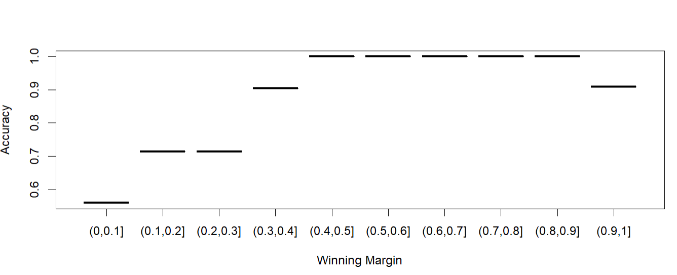
RF District Accuracy Vs. Win Margin

Slide 29
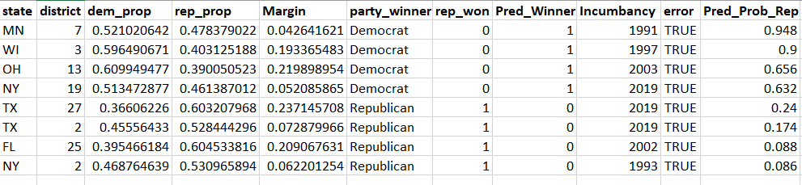
Outlying Districts

Slide 30
Questions?

Slide 31
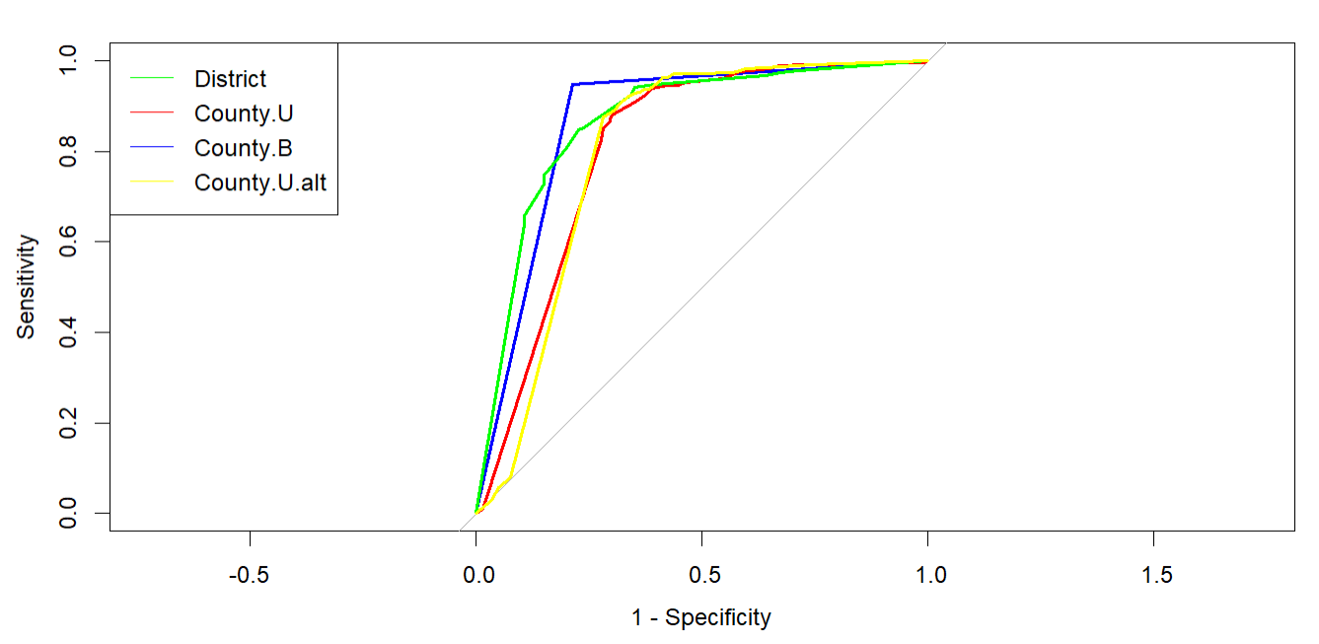
ROC Curve – Decision Tree

Slide 32
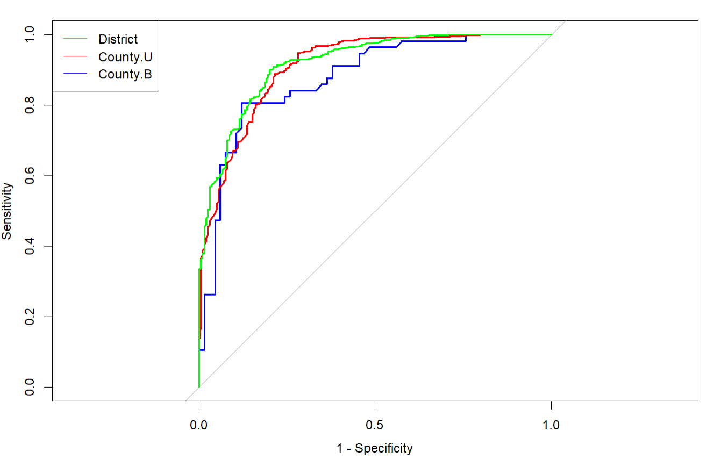
Random Forest ROC Curves

Slide 33
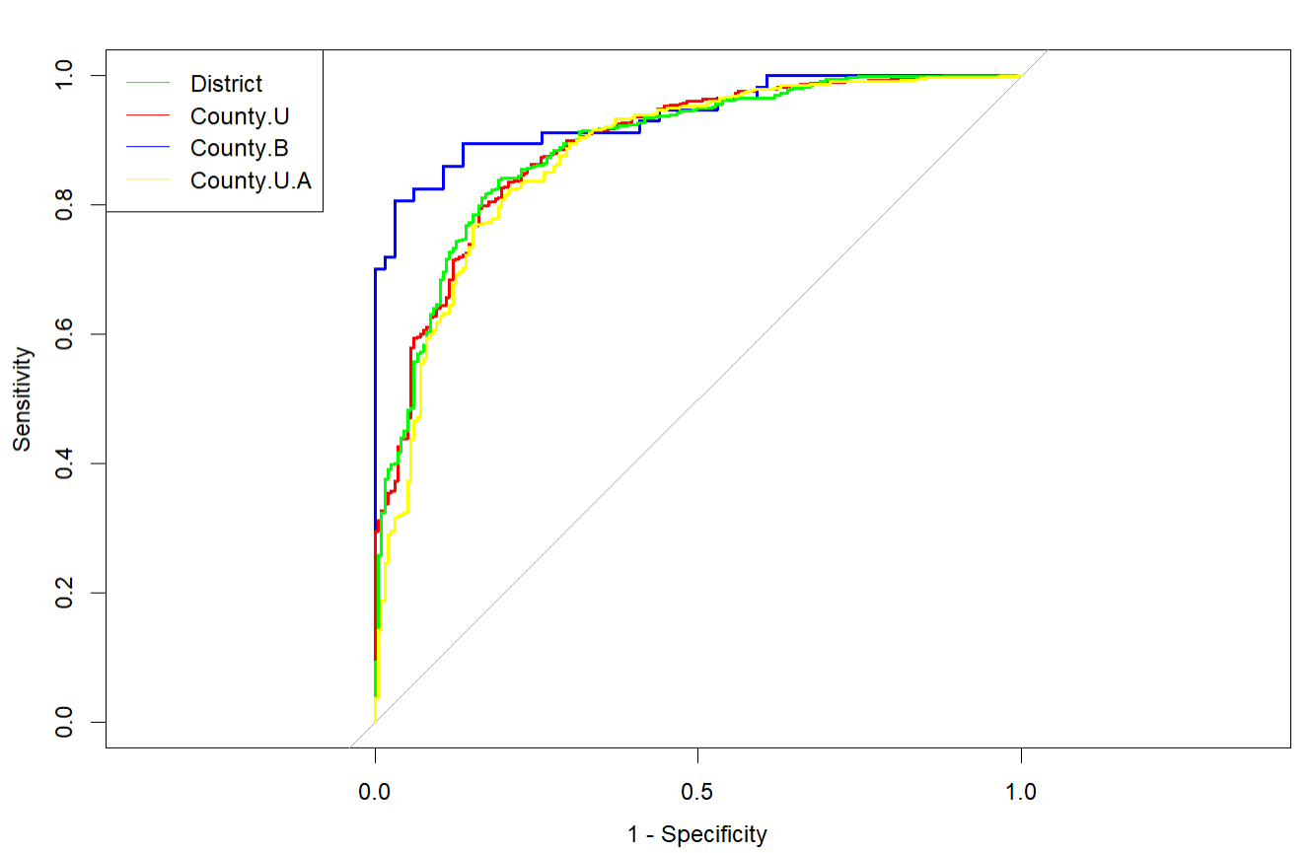
ROC Curve – Logistic Regression

Slide 34
Congressional Elections Background
Every 2 years, congressional elections are held in the U.S.
Country divided into 435 separate congressional districts.
Seats apportioned according to state population size
Each state must have at least one representative
Average district population – 710,000
Most districts – CA – 53
Fewest – 7 States have one district
Districts should be close to equal in population size.
Every 10 years districts are reapportioned by census.

Slide 35
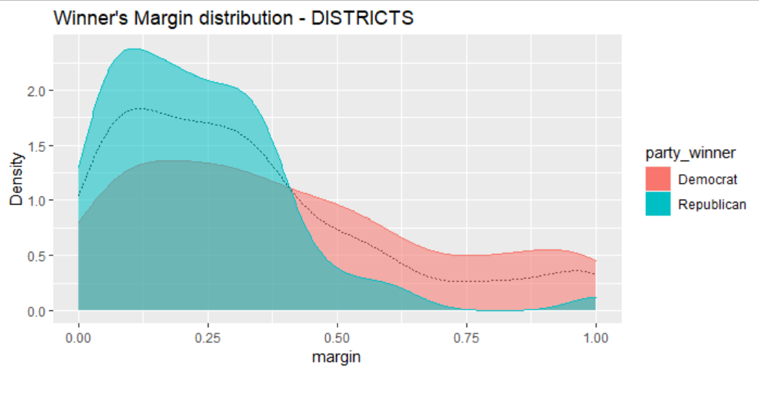
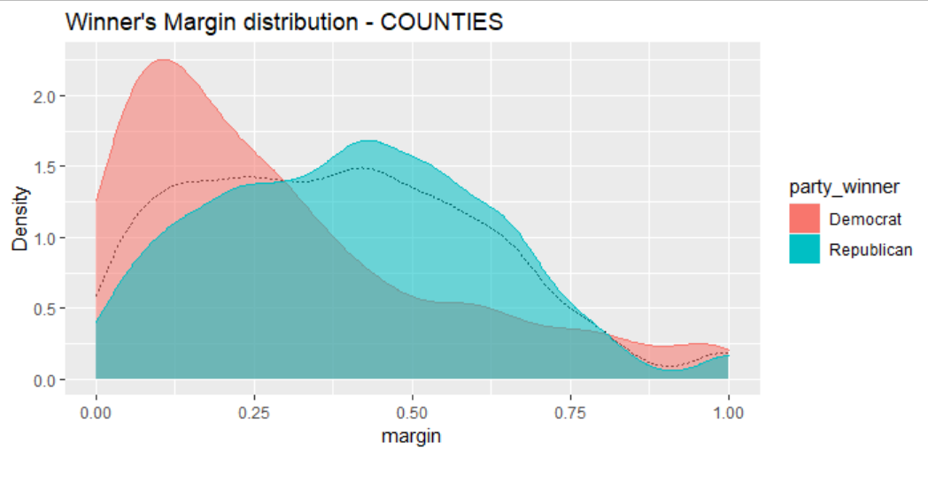
Distribution of Winning Margin

